Slide 1

A radial-basis function based approach to the scalp Laplacian estimate
Dezhong Yao Min Zeng
E-mail: dyao@uestc.edu.cn
School of Life Science & Technology
University of Electronic Science and Technology of China

Slide 2

  1. Introduction
  ----------------------------------
  Electroencephalography (EEG) and evoked potential(EP) are important tools for diagnosing or exploring the function of the nervous system regarding normal or pathological conditions.
  The spatial or topographical features provide an access to the detection of focal EEG phenomena that have a relationship to focal pathology or to localized brain function.

Slide 3

  The scalp Laplacian mapping (LM)
  is a well developed approach to construct invasive high-resolution EEG/EP imaging maps,
  which is based on the 2D Laplace operation on the scalp potential, thus offering a higher spatial resolution map than that done by the conventional scalp potential map.

Slide 4
  Current two categories:
  local approach
  and global approach

Slide 5

The local approach to LM
locally estimates the Laplacian at an electrode site using a difference numerical estimator.
A typical example is the Hjorth’s second order finite difference scheme which assumes a planar scalp surface and a rectangular electrode array to facilitate the second order finite difference calculations .

Slide 6
The local approaches have advantage of ease of computation and implementation, and have drawbacks of:
map discontinuities and extrema located at recording sites;
a loss of information in the Laplacian estimation on border electrode sites

Slide 7
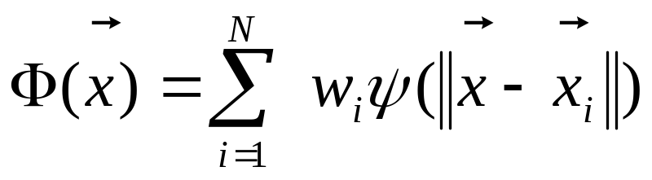
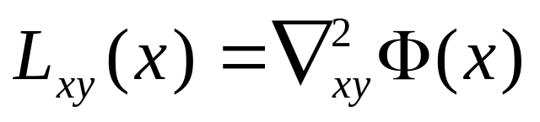
The global approach to LM
1) first constructing a global interpolation function
2) then analytically applying a two order and two dimensional Laplace differentiation calculation on the global interpolation function

Slide 8
Global functions used for the global interpolation:
spherical spline function (SSF); 3D thin plate spline function.
The main advantage is that it can estimate Laplacian for both inner and border electrode sites.
And in general, the spline/global Laplacians perform better than the local Laplacians.
The main disadvantage is that it sometimes produces a distorted Laplacian estimate due to its global mathematical interpolation scheme.

Slide 9
In summary, both global and local approaches have their own advantages and disadvantages, and the sticking points are just the local or global characteristics of their interpolation functions.
Is there a moderate approach that is better than the two approaches?

Slide 10
2. New Method RBF approach
---------------------------------------------
A moderate approach:
different from the global/local approach,
the spatial support range of the interpolation function is neither a local nor a global interpolation function
its spatial support range should be moderate and tunable

Slide 11
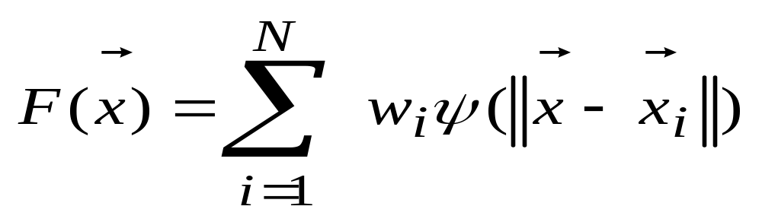
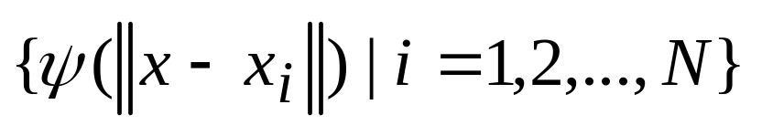
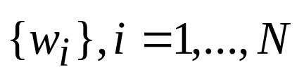
A Moderate approach
---Rdial basis function(RBF) approach
Principle
Step 1: Scalp potential interpolation
(1)
is a set of N arbitrary
(generally non-linear) functions, known as RBFs.
are the unknown weights.

Slide 12
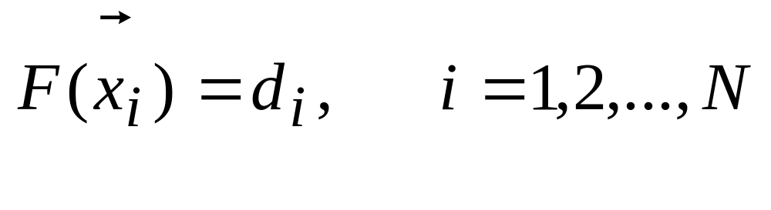
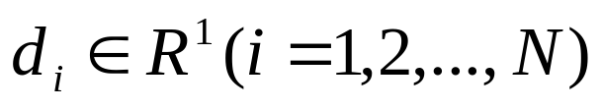
The interpolation problem is solved by assuming
(2)
is the corresponding scalp potnetial data

Slide 13
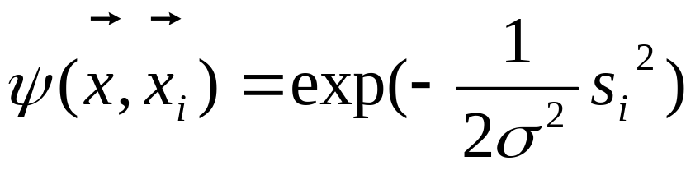


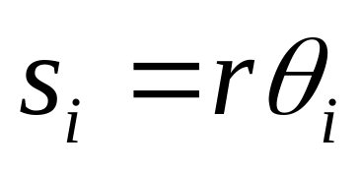
The Gaussian function is used as the radial basis function:
(3)
For a spherical surface interpolation, assuming the distance s_{i} as the smallest arc length between and on the sphere surface, i.e.
(4)

Slide 14
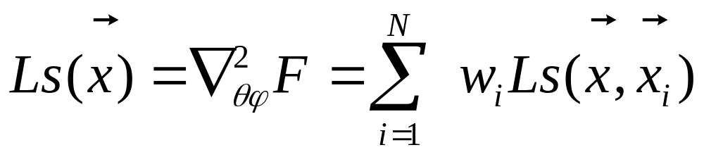
Step 2:
The scalp Laplacian is
The Laplacian is consisted of a linear summation of the contributions from all the measurement sites .

Slide 15
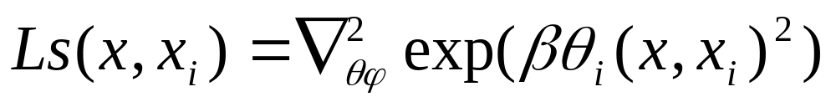
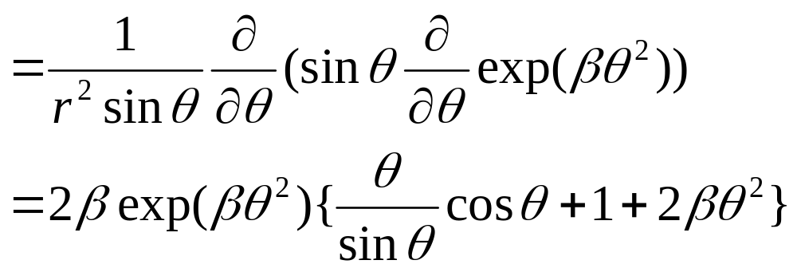

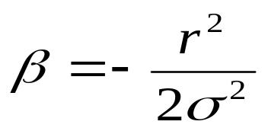
where the RBF based Laplacian interpolation function is
The contribution of a measurement site to a desired point is decided by the relative arc angle .
is a control parameter of the spatial support range of the RBF:

Slide 16
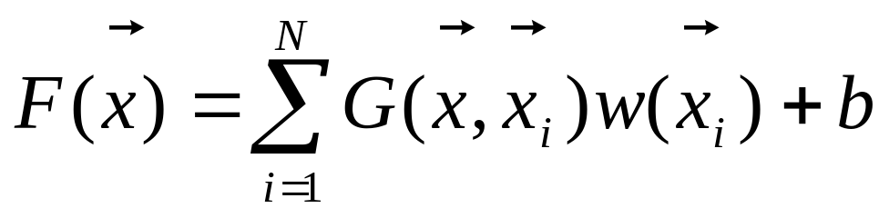
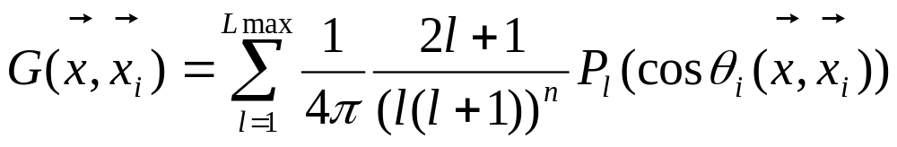
A global approach (for comparison )
--- Spherical spline function(SSF) approach
Step 1: global function interpolation
Where the SSF is

Slide 17
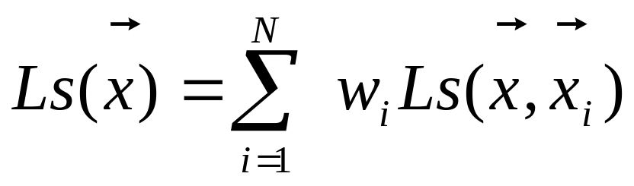
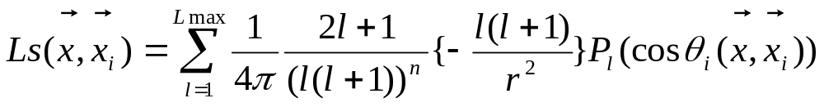
Step 2 Global Laplacian
Where the SSF based Laplacian interpolation function is
Where n is a control parameter

Slide 18
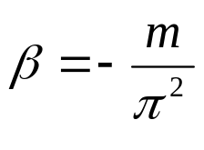
There are two intrinsic differences between these two approaches.
1) The interpolation basis functions are different.
RBF ------- SSF
2) The modifiable parameters are different.
m -------- n
(
)

Slide 19
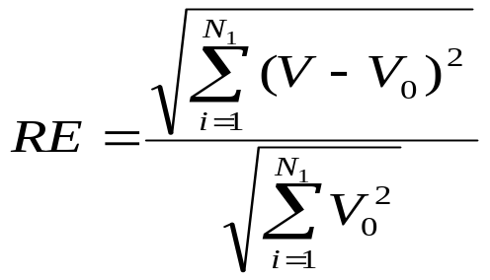
3. Description of the Numeric Tests
---------------------------------------------
1) The head model is a four-concentric spheres volume conductor.
2) The Relative Error (RE) is defined as
where V are the reconstructed potentials or the Laplacians,
V₀ are the corresponding theoretical potentials or Laplacians.

Slide 20
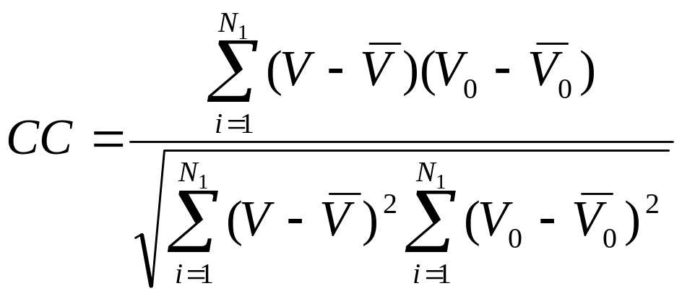
3) The Pearson Correlation Coefficient (CC) is defined as

Slide 21
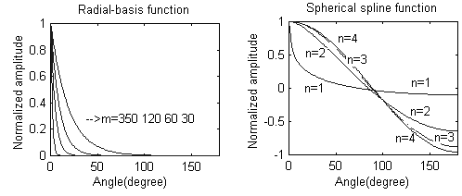
4.Comparison of SSF and RBF interpolation functions
---------------------------------------------------
Fig.1. Radial-basis (left) and spherical spline (right) potential interpolation functions.

Slide 22
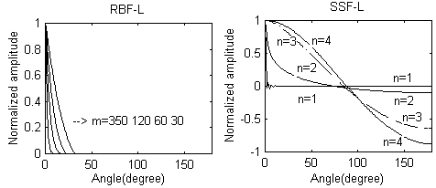
Fig.2. Radial-basis (left) and spherical spline (right) Laplacian interpolation functions.

Slide 23
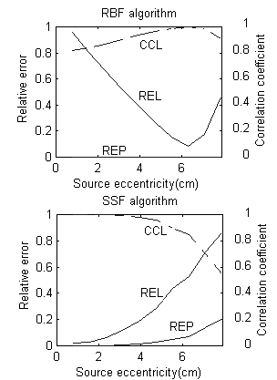
Numeric results
-----------------------------------
Fig.4. REs and CCs versus source eccentricities. (REP - RE of the potential, REL - RE of the Laplacian, CCL- CC of the Laplacian)
For shallow region: RBF is much better than SSF (Larger CCL, smaller REL and REP)

Slide 24
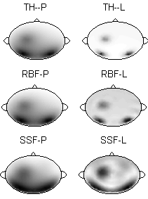
Fig.6 The maps of potentials and Laplacians.
The sources are at rr=7.0356cm, the electrode number is 120, the control parameter in RBF is m=60, and the n in SSF is 2. P means potential, L means Laplacian, TH means theoretical value, RBF means recovered by the RBF based approach, SSF means recovered by the SSF based approach.
For sources at eccentricity 7.0356cm,
RBF is much better than SSF

Slide 25
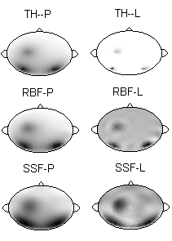
Fig.7. The maps of potentials and Laplacians.
(The sources are at rr=7.85cm. The meanings of the labels are the same as those in Fig.6)
For sources at r=7.85cm， RBF is much better than SSF

Slide 26
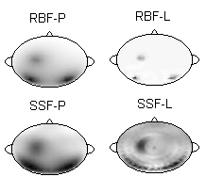
Fig.8. The maps of potentials and Laplacians. The sources are at rr=7.85cm, the electrode number is 500. The control parameter in RBF is m=350, and the n in SSF is 2.
For sources very close to the inner surface of the skull, SSF fail, RBF still work.

Slide 27
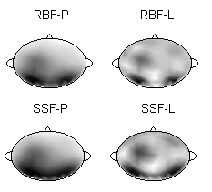
Fig.9.The maps of potentials and Laplacians recovered from a noisy scalp potential.
The map of the noiseless theoretical potential is the TH-P in Fig.6. The noise signal ratio in standard deviation is 15%.
For noisy scalp data, RBF approach is better than SSF approach

Slide 28
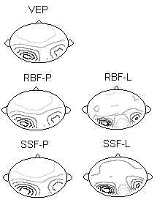
Fig.10. Contour maps of an empirical visual evoked potential and recovered potentials and Laplacians.
VEP is an empirical visual evoked potential. The other maps are the recovered maps, and the meanings of the labels are same as above. (The VEP data is provided by the Beijing Lab of Cognitive Science, University of Science and technology of China).
For real ERP data, RBF is better than SSF

Slide 29
Discussion and conclusion
--------------------------
The scalp Laplacian has the following properties :
1) It is a scalar quantity whose topographic distribution can be easily represented just like the scalp potential.
2) It is independent of the location of the reference electrode used for potential, and its estimation from the potential does not need any information of the inner head model.
3) Compared to magnetic fields, Laplacian depends on both radial and tangential componenets of brain generators.
4) Compared to potential distributions, Laplacian distributions emphasize shallow generators.
5) Surface Laplacian may be approximately interpreted as the impressed surface current density.
6) It is roughly proportional to the cortical potential distribution.

Slide 30
For the technique aspect of the surface Laplacian, there are two general approaches:
For the local approach, it suffers from such as local noise effects and can not properly process border electrodes The reason is that the local approach methods utilize only potential of the closest surface locations, it is difficult for it to discriminate noise from signal, and for a border electrode there is not enough neighbor electrodes for Laplacian estimate.

Slide 31
For the global approach with the spline techniques:
the Laplacian at a scalp site is estimated on the basis of the potentials recorded from the array. It in general performs better than the local approach because it may partly smooth the noise .And it may predict the Laplacian of a border point by the global function.
the global interpolation function is not the actual potential function, it is an approximate function of the actual function obtained by a fit to the measured data.
In general, such a fit is based on a least square error criterion which is dominated by the relative large error elements and resulted in a distorted global Laplacian estimate function

Slide 32
The new RBF algorithm
which is based on the Gaussian radial-basis function.
Such a RBF is a focus adaptable function, and it looks like a moderate approach over the existed global and local approaches.
Its wider spatial support range than that of the local approach makes it able to partly removing noises .
Its narrower spatial support range than that of the global approach lends it ability to avoid the effect of a spike-like noise to far sites.
In addition, its spatial support range can be tuned by tuning the control parameter m.

Slide 33
7. CONCLUSION
For a spherical model:
1. The global approach is better than the Local approach ( References)
2. Moderate approach is better than the global approach ( This work)
3. The moderate approach (RBF) is the best approach at present!

Slide 34

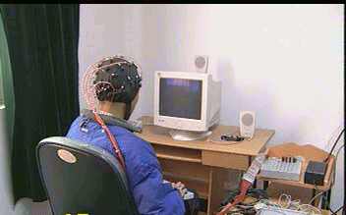
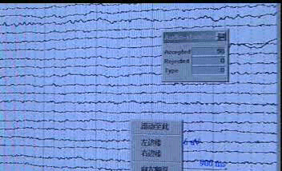
Thanks!
EEG/ ERP Lab at UESTC

